Slide 1

A Web-Based Real-Time Person Identification System for Intelligent Surveillance Using OpenCV and Deep Learning DSA0216-Computer Vision with Open CV for Modern AI
GUIDED BY:
Dr. Senthilvadivu S (Professor)
Dr. Kumaragurubaran T (Professor)
PRESENTED BY:
P. Dada Kalander (192424272) M. Satwik (192424339)
Y. Pawan (192424294)

Slide 2



Agenda
Abstract
Introduction
Literature Review
Problem statement
Objectives
Proposed methodology
Modules
Architecture diagram
Implementation
Future scope
Conclusion
References

Slide 3


Abstract
This project presents a real-time intelligent surveillance system that integrates face detection, face recognition, and YOLOv8-based object detection to enhance security and monitoring efficiency. The system is capable of identifying registered users, detecting unknown individuals, and recognizing multiple objects simultaneously from live video streams. Advanced deep learning algorithms are used to achieve high accuracy in face recognition and approximately 95% accuracy in unknown person detection, ensuring reliable performance under normal lighting conditions. The system processes video frames in real time with an average response time of less than 2 seconds, making it suitable for practical security applications. YOLOv8 is utilized for fast and efficient object detection, enabling the system to detect various objects with minimal latency. A structured database architecture is implemented using JSON and SQLite to store user information, recognition logs, and system activity records. Additionally, system performance metrics such as detection accuracy, response time, and latency are recorded in CSV format for analysis and evaluation.

Slide 4

Introduction
Surveillance systems are widely used for security monitoring.
Traditional CCTV requires manual observation.
Manual monitoring is time-consuming and error-prone.
Real-time identification improves security efficiency.
Deep learning enables accurate detection and recognition.
This project proposes a web-based intelligent surveillance system.

Slide 5

Problem statement
CCTV systems only record video.
Manual monitoring is inefficient.
Real-time identification is difficult.
Lighting and occlusion reduce accuracy.
Unknown person detection is challenging.
Need for an intelligent automated surveillance system.

Slide 6

Objectives
To develop a real-time person detection system.
To implement accurate face recognition.
To register and manage authorized users.
To detect unknown individuals instantly.
To generate real-time alerts.
To build a web-based surveillance dashboard.

Slide 7
Literature Review
Author / Year | Area of Study | Advantages | Disadvantages / Limitations
Perez-Montes et al., 2023 | Real-time face verification methods for surveillance systems | Lightweight deep learning models for real-time use; Evaluated pose & resolution challenges; Suitable for edge devices | Accuracy drops in poor lighting; Sensitive to occlusion; Requires GPU for high performance
Hussien & Abed, 2023 | Person Re-Identification using YOLOv5 and OSNet | Integrates object detection with re-ID; Works in multi-camera systems; Good performance on benchmark datasets | Moderate accuracy (~80%); Computational complexity; Limited real-world deployment testing
Zhang et al., 2023 | Vision-Language based Person Re-Identification | Multi-modal feature fusion; Handles viewpoint variation; Improved feature discrimination | High training cost; Complex model architecture; Needs large labeled datasets
Kumar et al., 2024 | Systematic Review of Facial Recognition Algorithms | Comprehensive comparison of CNN models; Highlights performance metrics; Useful for model selection | Struggles with bias & fairness issues; Affected by low resolution; High data dependency
Ali & Rahman, 2023 | Human Detection Techniques using YOLO Variants | Real-time detection; Improved detection in crowded scenes; Good benchmark results | Performance drops in heavy occlusion; Sensitive to lighting; Requires hardware acceleration
Singh et al., 2023 | Deep Learning based Person Re-Identification Survey | Covers datasets & evaluation metrics; Reviews embedding techniques; Identifies research trends | High computational cost; Limited guidance for real-time deployment; Focuses more on re-ID than face recognition

Slide 8
Proposed Methodology
Capture live video using OpenCV.
Detect persons using YOLO-based object detection.
Extract facial features using deep learning model.
Compare embeddings using Euclidean Distance.
Track individuals across frames using centroid tracking.
Generate alerts and display results on web dashboard.

Slide 9


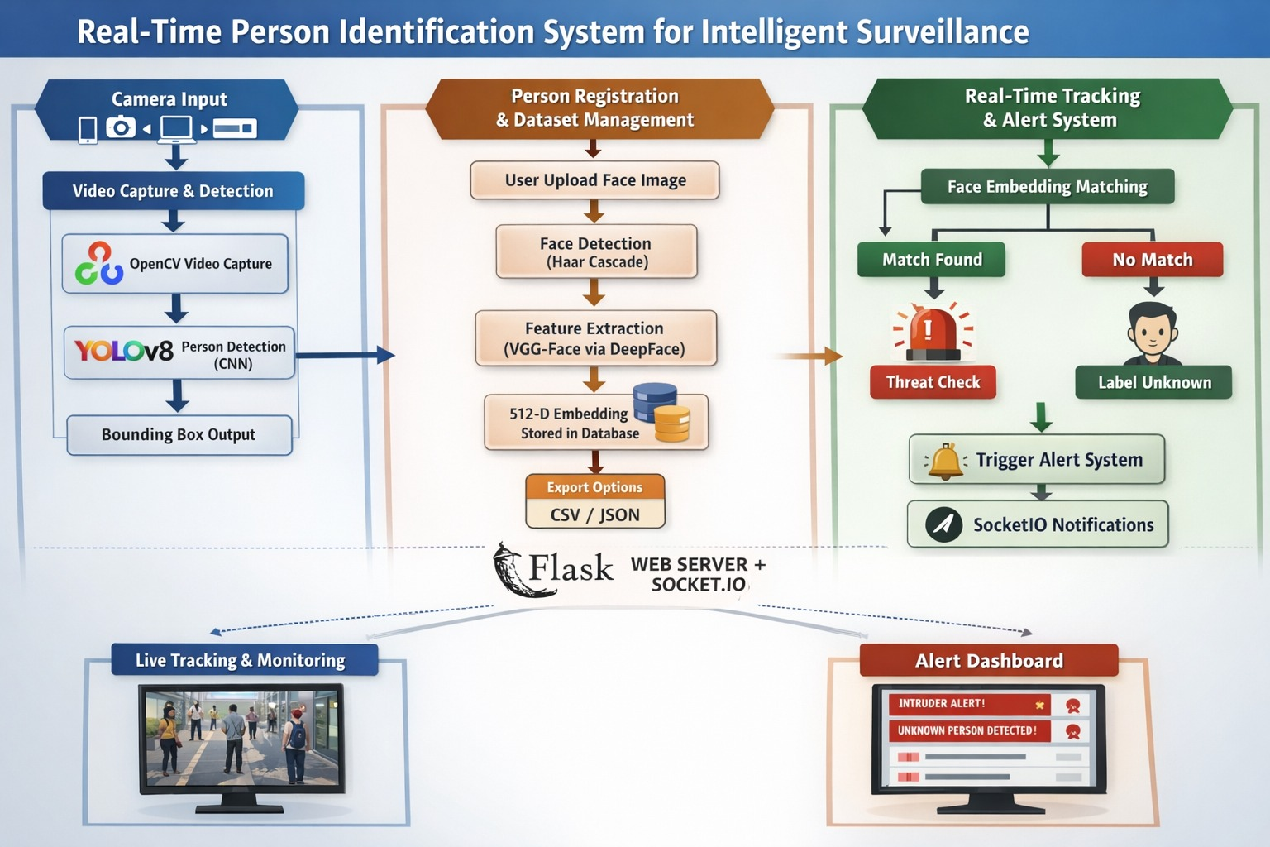
Architecture Diagram

Slide 10
Modules overview
Modules:
Video Capture & Person Detection
Person Registration & Dataset Management
Real-Time Tracking & Alert System

Slide 11
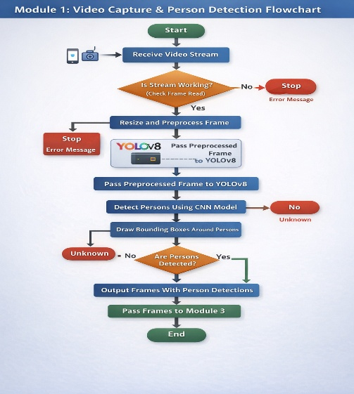
Module 1:Video Capture & Person Detection
Captures live video stream using OpenCV.
Detects persons in real time using YOLOv8.
Filters detections using confidence threshold scoring.
Applies frame skip optimization to improve processing speed.
Uses resolution downsampling for faster performance.
Calculates real-time FPS using a moving average algorithm.

Slide 12
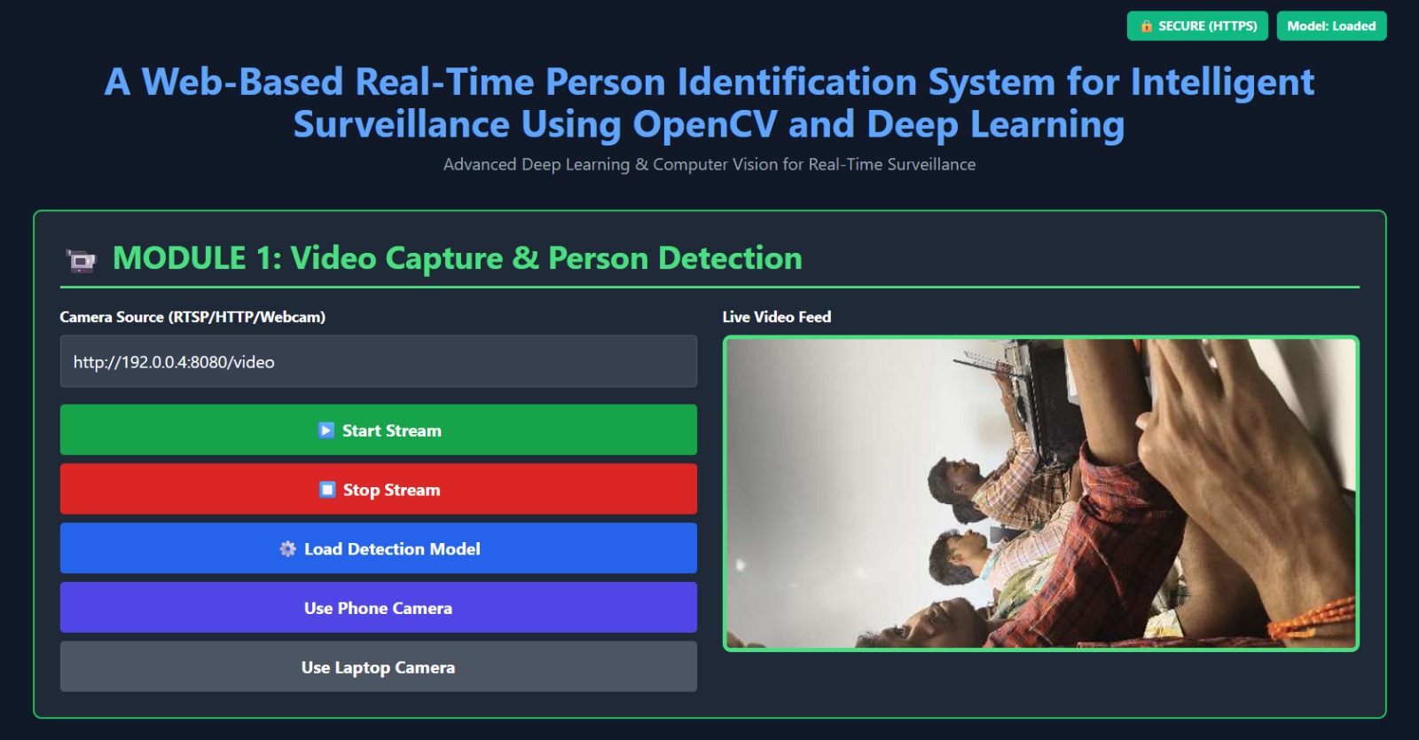
Implementation

Slide 13
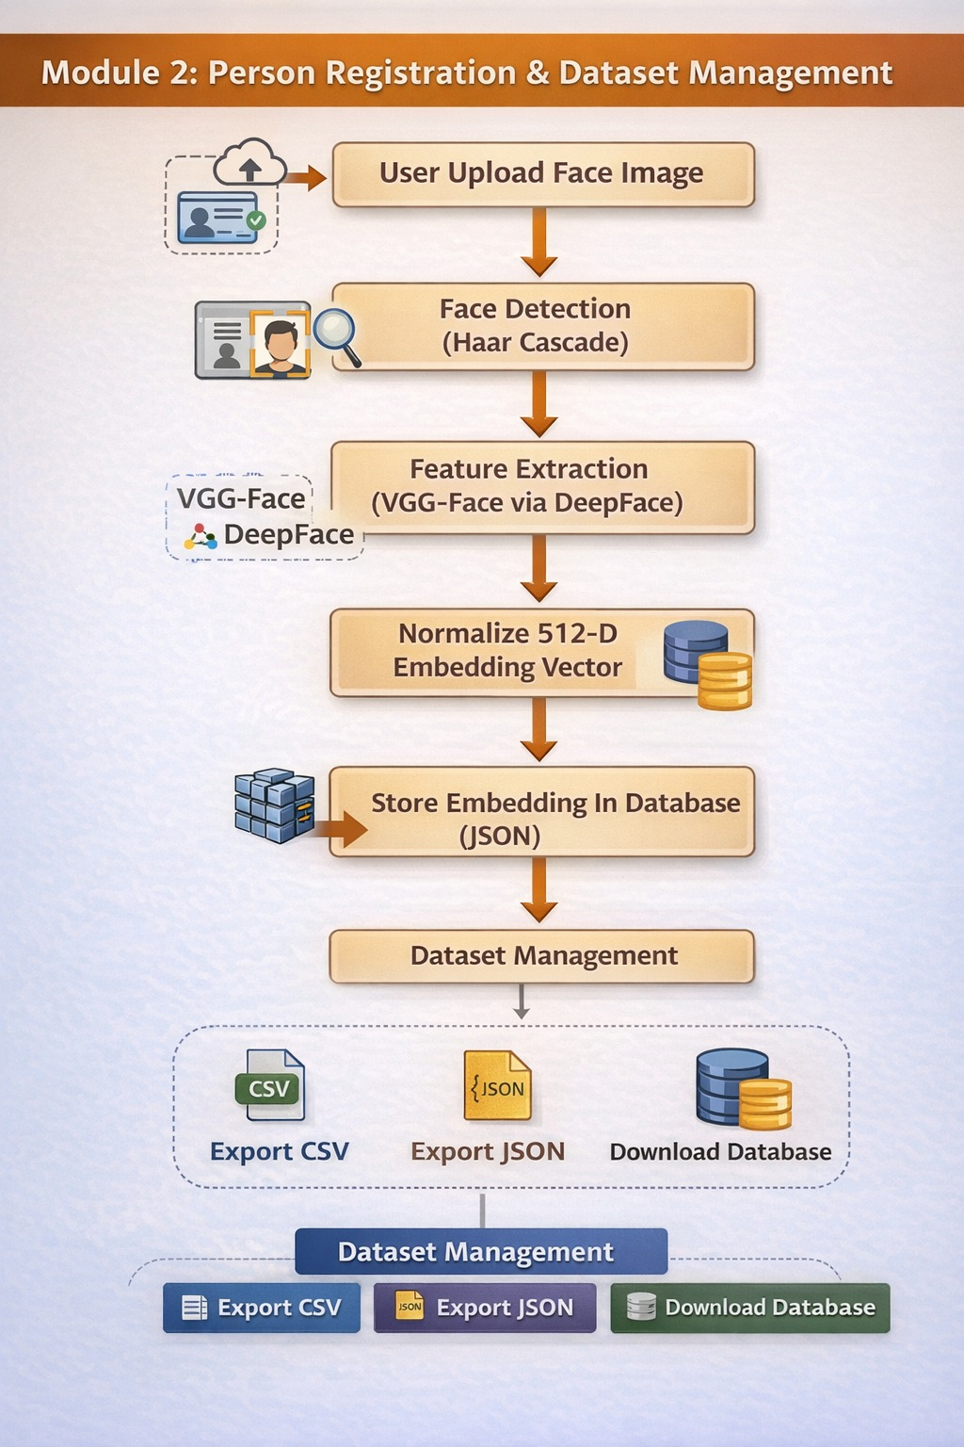
Module 2:Person Registration & Dataset Management
Registers authorized users with name and ID.
Captures face images during registration process.
Extracts facial embeddings using VGG-Face.
Stores embeddings securely in a database.
Compares embeddings using Euclidean Distance (L2 Norm).
Identifies individuals as “Recognized” or “Unknown” based on threshold.

Slide 14
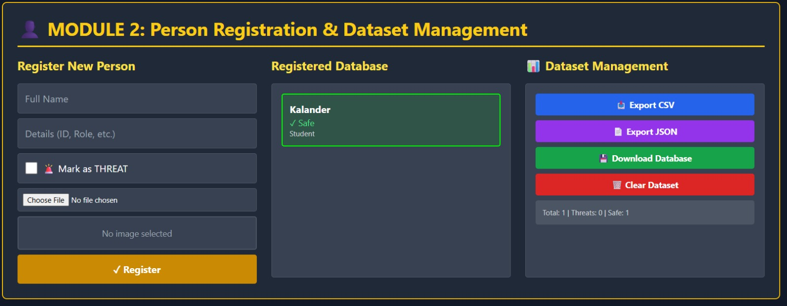
Implementation

Slide 15
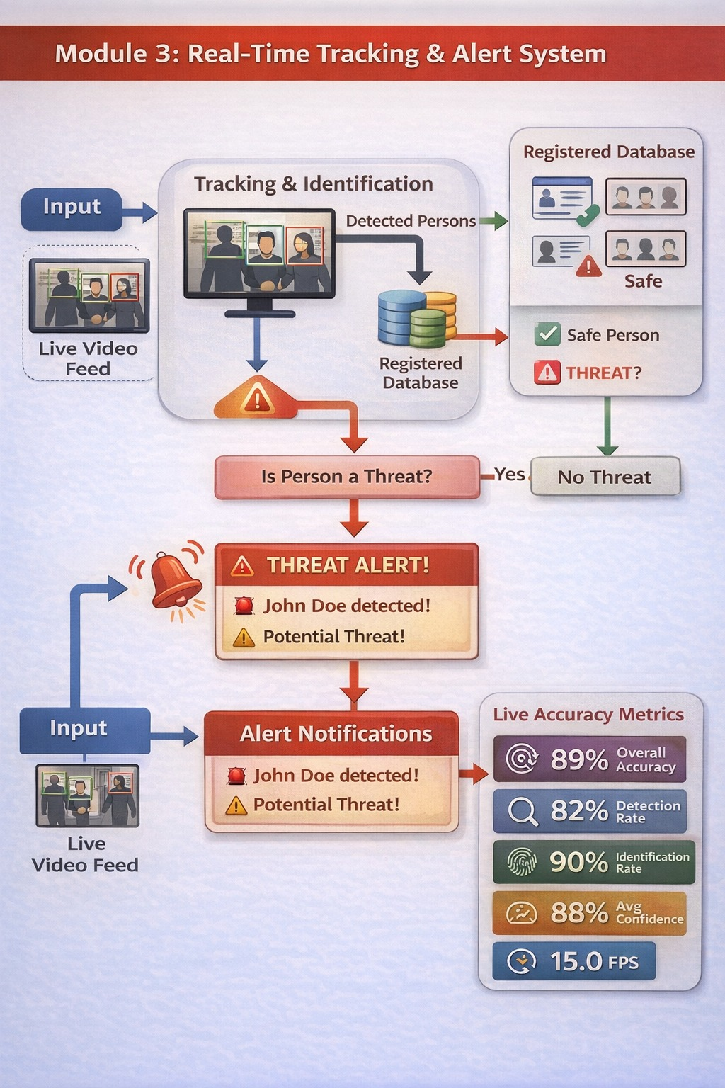
Module 3:Real-Time Tracking & Alert System
Tracks detected persons across consecutive frames.
Uses proximity-based centroid tracking for ID assignment.
Detects unknown individuals in real time.
Generates alerts for potential threats.
Implements threat alert cooldown to prevent repeated alerts.
Broadcasts alerts using Socket.IO on a Flask web dashboard.

Slide 16
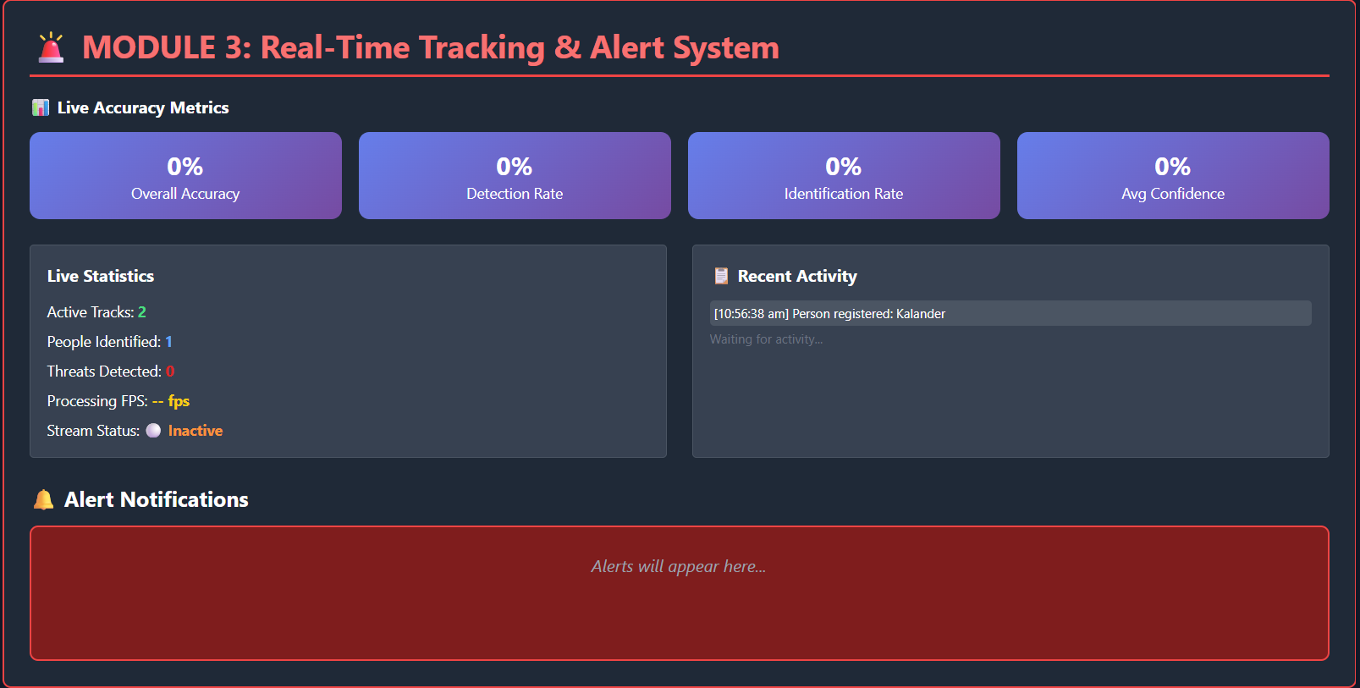
Implementation

Slide 17

Conclusion
The system performs real-time person detection and identification.
It automates surveillance monitoring effectively.
Face recognition improves identification accuracy.
Tracking ensures continuous monitoring of individuals.
Alert system enhances security response time.
The proposed solution provides a reliable smart surveillance framework.

Slide 18

Future scope
Integration with cloud-based storage and analytics.
Deployment on edge devices for faster processing.
Multi-camera synchronization and cross-camera tracking.
Implementation of advanced tracking algorithms (Deep SORT).
Integration with biometric systems (fingerprint, iris).
Enhancement using AI-based behavior analysis and anomaly detection.

Slide 19
References
Perez-Montes, A. et al., 2023. Real-Time Face Verification Methods for Surveillance Applications. IEEE Access.
Hussien, S. A., & Abed, A. A., 2023. Person Re-Identification using YOLO and OSNet. International Journal of Intelligent Systems.
Zhang, Y. et al., 2023. Vision-Language Based Person Re-Identification for Surveillance. Pattern Recognition Journal.
Kumar, R. et al., 2024. A Systematic Review of Facial Recognition Algorithms. Information Journal.
Singh, P. et al., 2023. Deep Learning Approaches for Person Re-Identification. Springer Multimedia Tools and Applications. on and Image Understanding.

Slide 20


